Slide 1
Web Services & REST
By :
Sujata Batra

Slide 2
Service –Oriented Architecture
A means of developing distributed systems where the components are stand-alone services.
Services may execute on different computers from different service providers.
Standard protocols have been developed to support service communication and information exchange.

Slide 3
Services or components?
A service can be defined as:
A loosely-coupled, reusable software component that encapsulates discrete functionality which may be distributed and programmatically accessed. A web service is a service that is accessed using standard Internet and XML-based protocols.
A critical distinction between a service and a component as defined in component-based software engineering is that services are independent.
Services do not have a ‘requires’ interface.
Services rely on message-based communication with messages expressed in XML.

Slide 4
Benefits of SOA
Services can be provided locally or outsourced to external providers.
Services are language-independent.
Investment in legacy systems can be preserved.
Inter-organizational computing is facilitated through simplified information exchange.

Slide 5
SOA and Web Services
Service-oriented architecture is an architectural style
Derived from the client-server architectural style.
Clients (service consumers or requesters) and servers (service providers) connected by a service “bus”.
Services defined using formal interfaces (contracts).
Service bus supports point-to-point and messaging styles of communication.
Support for system qualities, e.g., security and transaction management.
Web services
Services provided in a SOA deployed over the web.

Slide 6
Key standards
SOAP (Simple Object Access Protocol)
A message exchange standard that supports service communication.
WSDL (Web Service Definition Language)
This standard allows a service interface and its bindings to be defined.
UDDI (Universal Description Discovery and Integration)
Defines the components of a service specification that may be used to discover the existence of a service.

Slide 7
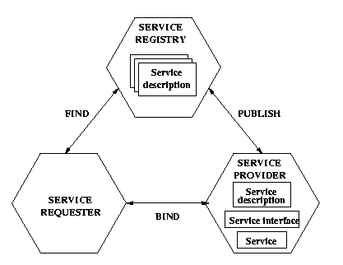
Service-oriented architecture
UDDI
SOAP
WSDL

Slide 8
SOAP messages
SOAP Envelope
SOAP is based on message exchanges
Messages are seen as envelops where the application encloses the data to be sent
A message has two main parts:
header: which can be divided into blocks
body: which can be divided into blocks
SOAP does not say what to do with the header and the body, it only states that the header is optional and the body is mandatory
Use of header and body, however, is implicit. The body is for application level data. The header is for infrastructure level data
SOAP header
Header Block
SOAP Body
Body Block

Slide 9
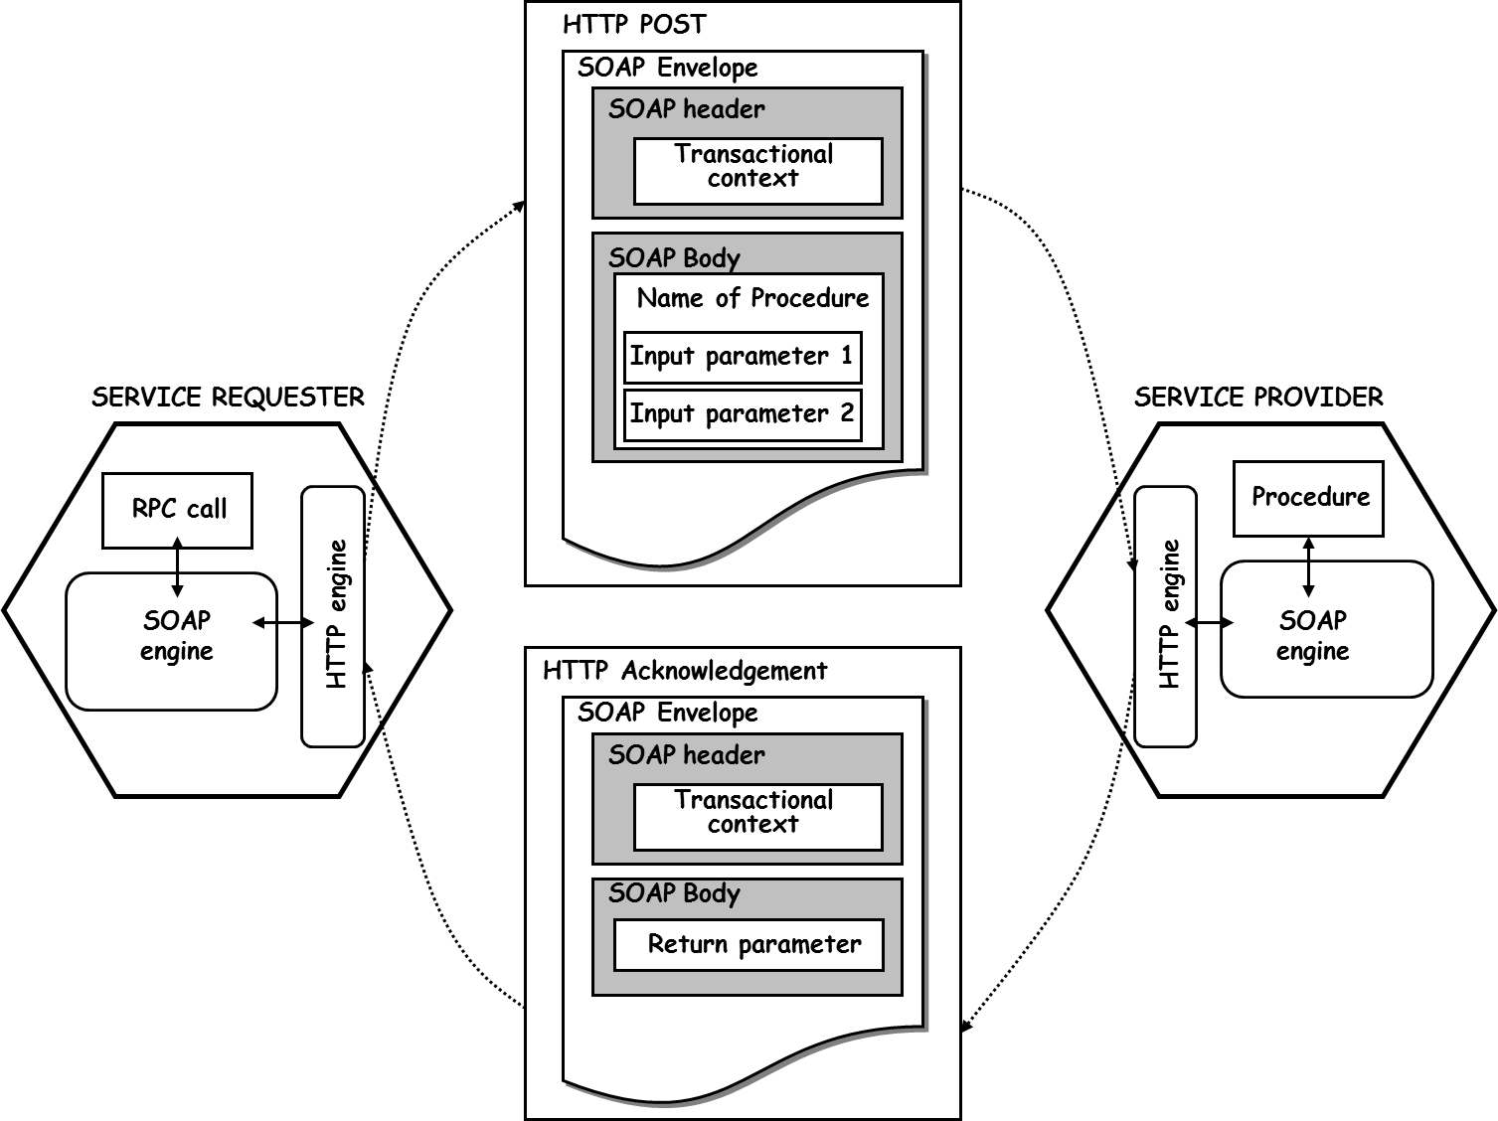

Slide 10
REST
REST stands for Representational State Transfer
It is an architectural pattern for developing web services as opposed to a specification.
REST was first described by Roy Fielding in 2000
REST web services communicate over the HTTP specification, using HTTP vocabulary:
Methods (GET, POST, etc.)
HTTP URI syntax (paths, parameters, etc.)
Media types (xml, json, html, plain text, etc)
HTTP Response codes.

Slide 11
Rest
Representational
Clients possess the information necessary to identify, modify, and/or delete a web resource.
State
All resource state information is stored on the client.
Transfer
Client state is passed from the client to the service through HTTP.

Slide 12
Resource
In a REST based architecture you typically have a REST server which provides access to the resources
and a REST client which accesses and modify the REST resources.
Every resource should support the HTTP common operations.
Resources are identified by URI

Slide 13
Content negotiation
REST allows that resources have different representations,
e.g. text, xml, json etc.
The rest client can ask for specific representation via the HTTP protocol .

Slide 14
Http-Rest
The HTTP request is sent from the client.
Identifies the location of a resource.
Specifies the verb, or HTTP method to use when accessing the resource.
Supplies optional request headers (name-value pairs) that provide additional information the server may need when processing the request.
Supplies an optional request body that identifies additional data to be uploaded to the server (e.g. form parameters, attachments, etc.)

Slide 15
Http-Rest
Sample Client Requests:
A typical client GET request:
A typical client POST request:
GET /view?id=1 HTTP/1.1
User-Agent: Chrome
Accept: application/json
[CRLF]
POST /save HTTP/1.1
User-Agent: IE
Content-Type: application/x-www-form-urlencoded
[CRLF]
name=x&id=2

Slide 16
Http-Rest response
The HTTP response is sent from the server.
Gives the status of the processed request.
Supplies response headers (name-value pairs) that provide additional information about the response.
Supplies an optional response body that identifies additional data to be downloaded to the client (html, xml, binary data, etc.)

Slide 17
Sample Server Responses:
Response Status
HTTP/1.1 200 OK
Content-Type: text/html
Content-Length: 1337
[CRLF]
<html>
<!-- Some HTML Content. -->
</html>

Slide 18
Rest web service framework
A REST service framework provides a controller for routing HTTP requests to a request handler according to:
The HTTP method used (e.g. GET, POST)
Supplied path information (e.g /service/listItems)
Query, form, and path parameters
Headers, cookies, etc.

Slide 19
SOAP Vs REST
No. | SOAP | REST
1) | SOAP is a protocol. | REST is an architectural style.
2) | SOAP stands for Simple Object Access Protocol. | REST stands for REpresentational State Transfer.
3) | SOAP can't use REST because it is a protocol. | REST can use SOAP web services because it is a concept and can use any protocol like HTTP, SOAP.
4) | SOAP uses services interfaces to expose the business logic. | REST uses URI to expose business logic.
5) | JAX-WS is the java API for SOAP web services. | JAX-RS is the java API for RESTful web services.
6) | SOAP defines standards to be strictly followed. | REST does not define too much standards like SOAP.
7) | SOAP requires more bandwidth and resource than REST. | REST requires less bandwidth and resource than SOAP.
8) | SOAP defines its own security. | RESTful web services inherits security measures from the underlying transport.
9) | SOAP permits XML data format only. | REST permits different data format such as Plain text, HTML, XML, JSON etc.
10) | SOAP is less preferred than REST. | REST more preferred than SOAP.

Slide 20
Rest Frameworks
Jersey
RestEasy
Apache CXF

Slide 21
Http Methods
GET
PUT
updates a resource.
DELETE
removes the resources.
POST
creates a new resource

Slide 22
Restful web service
A RESTFul webservices are based on the HTTP methods and the concept of REST.
A RESTFul webservice typically defines the base URI for the services,
the supported MIME-types (XML, Text, JSON, user-defined,..)
and the set of operations (POST, GET, PUT, DELETE) which are supported.

Slide 23
Jersey
Jersey is the reference implementation for this specification.
Jersey contains basically a REST server and a REST client.
The core client can be used provides a library to communicate with the server.
On the server side Jersey uses a servlet
which scans predefined classes to identify RESTful resources.
Via the web.xml configuration file for your web application,

Slide 24
Jersey Servlet
This servlet analyzes the incoming HTTP request
selects the correct class and method to respond to this request.
This selection is based on annotations in the class and methods.
Jersey servlet will be instructed via the web.xml to scan certain packages for data classes.
JAX-RS supports the creation of XML and JSON via the Java Architecture for XML Binding (JAXB).

Slide 25
Annotation | Description
@PATH(your_path) | Sets the path to base URL + /your_path. The base URL is based on your application name, the servlet and the URL pattern from the web.xml" configuration file.
@POST | Indicates that the following method will answer to a HTTP POST request
@GET | Indicates that the following method will answer to a HTTP GET request
@PUT | Indicates that the following method will answer to a HTTP PUT request
@DELETE | Indicates that the following method will answer to a HTTP DELETE request

Slide 26
Annotation | Description
@Produces(MediaType.TEXT_PLAIN [, more-types ]) | @Produces defines which MIME type is delivered by a method annotated with @GET. In the example text ("text/plain") is produced. Other examples would be "application/xml" or "application/json".
@Consumes(type [, more-types ]) | @Consumes defines which MIME type is consumed by this method.
@PathParam | Used to inject values from the URL into a method parameter. This way you inject for example the ID of a resource into the method to get the correct object.

